Slide 1
Unit2 After school
(Story time)

Slide 2

Teaching aims:
1.能听懂、会说，会读，会写：Wednesday，Saturday,
Sunday, Tuesday, Thursday, Friday, get up.
2.能听懂、会说，会读词汇：All right, after school, go,
match, today.
3.能听懂、会说，会读句型： I have…. He/She has….
We don’t have….What day is it today? It’s…. What a pity!

Slide 3

Enjoy the song

Slide 4
Let’s learn
What day is it today?
今天星期几？
It’s …

Slide 5
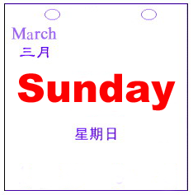
Let’s learn
What day is it today?
It’s Sunday.

Slide 6
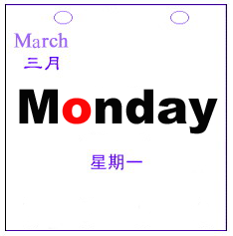
Let’s learn
What day is it today?
It’s Monday.

Slide 7
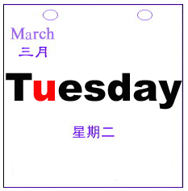
Let’s learn
What day is it today?
It’s Tuesday.

Slide 8
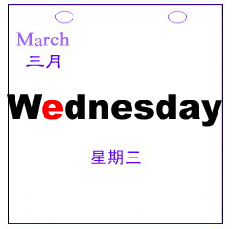
Let’s learn
What day is it today?
It’s Wednesday.

Slide 9
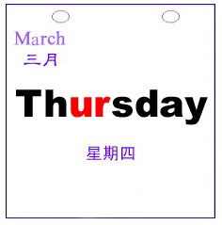
Let’s learn
What day is it today?
It’s Thursday.

Slide 10
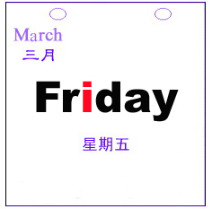
Let’s learn
What day is it today?
It’s Friday.

Slide 11
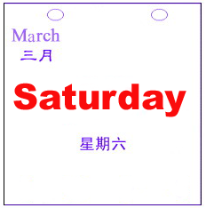
Let’s learn
What day is it today?
It’s Saturday.

Slide 12
Know more
1.在英语中，一周的第一天是Sunday。
2.星期的全写单词的开头第一个字母要大写。
3.在星期几的前面用介词on，如on Sunday 在周日。
4.记住这些缩写形式噢：
SUN=Sunday MON=Monday
TUE=Tuesday WED=Wednesday
THUR=Thursday FRI=Friday
SAT=Saturday

Slide 13
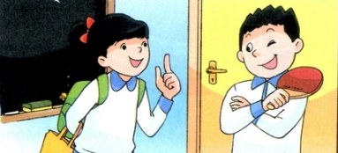
Watch and match
What do they do after school?
放学后
Liu Tao
play table tennis
Mike
a football match
Su Hai
一场足球比赛
a swimming lesson
Su Yang
一节游泳课

Slide 14
Watch and match
What do they do after school?
Liu Tao
play table tennis
Mike
a football match
Su Hai
a swimming lesson
Su Yang

Slide 15
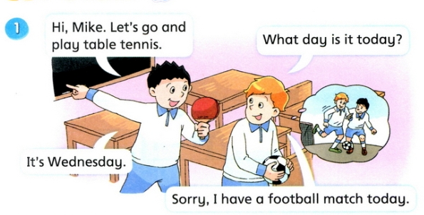
Let’s read
Let’s=let us让我们
去
Hi, Mike. Let’s go and
play table tennis.
What day is it today?
It’s Wednesday.
Sorry, I have a football match today.
比赛

Slide 16
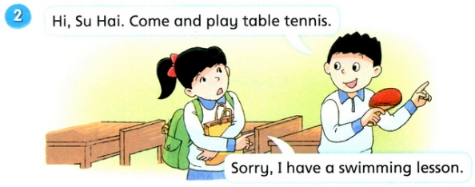
Let’s read
Hi, Su Hai. Come and play table tennis.
Sorry, I have a swimming lesson.

Slide 17
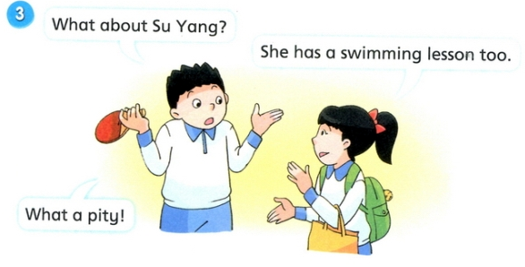
Let’s read
What about Su Yang?
She has a swimming lesson too.
What a pity!
真遗憾！

Slide 18
Know more
1.have, has意为：有，吃，喝，举办等。
2.have一般用在第一，二人称及复数主语后。
如：I, You, We, They, Su Hai and Su Yang等。
3.has一般用在第三人称及单数主语后。
如：He, She, It, Gao Shan等。

Slide 19
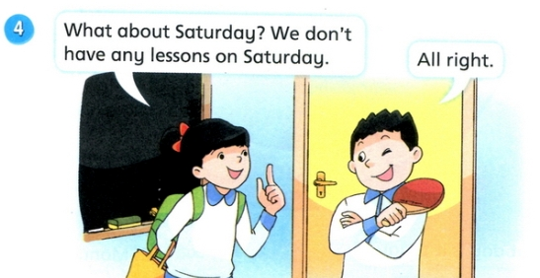
Let’s read
don’t=do not
What about Saturday? We don’t
have any lessons on Saturday?
All right.
好的。

Slide 20
Watch and repeat

Slide 21
Good Reader
有表情地分组对话，并
注意模仿语音语调噢！

Slide 22
Let's act
四人一小组，表演课文对话，比一比哪组表演的最棒！

Slide 23
1.复述Story time中的故事。
2.预习Cartoon time内容。

